Slide 1
Do now
Matching!
Measuring tool | Description | Strength | Weakness
Observation | Individuals are asked to comment freely without limitation on their attitude towards a particular topic | Descriptive, very specific, interesting, useful. | Have to assume underlying attitude from behaviour.
Open-ended interviews | A persons attitude is measured by them indicating the extent to which they agree or disagree with statements. | Useful when attitudes being investigated people may not want to be honest about. | Lack of detail, restricting (does not allow participants to explain).
Likert Scale | When a person is observed within a specific circumstance or environment and their behaviour is recorded. | Easy to analyse, due to associating numbers with statements. | Difficult to analyse, subject to social desirability.
Reminders:
Phones away
Bags on floor
Books out
Pens out
Reminders
Extended Response on Social Psych and Culture and Values – Week 3

Slide 2
Peer review and marking
Feedback sheet
On a piece of paper write two headings
Instructions:
Leave your draft on your table with the feedback sheet
Bring a pen and a marking key
You will sit at another students desk
4 minutes to read
2 minutes to review with the marking key
2 minutes to give SPECIFIC feedback
Glow | Grow
What did your peer do well? Structure. Gave examples with context. Followed the marking key | What did they miss? What definitions did they miss / not complete. Did the sentences make sense? Too much waffle

Slide 3

Success Criteria
Learning Intention
By the end of the lesson I will be able to:
Explain data collection tools to measure attitudes
Culture and values Syllabus Points
attitude formation – Tripartite model
tools for measuring attitudes
o observational methods
o qualitative self-report methods – interviews and focus groups
o quantitative self-report measures – rating scales
racism
o causes of prejudice
o reducing prejudice
o (viewing activity – Remember the Titans
cultural influences on attitudes
o individualistic cultures
o collectivist cultures
Research ‘Focus groups’
Create a data collection tool to measure attitudes
Complete practice exam questions

Slide 4
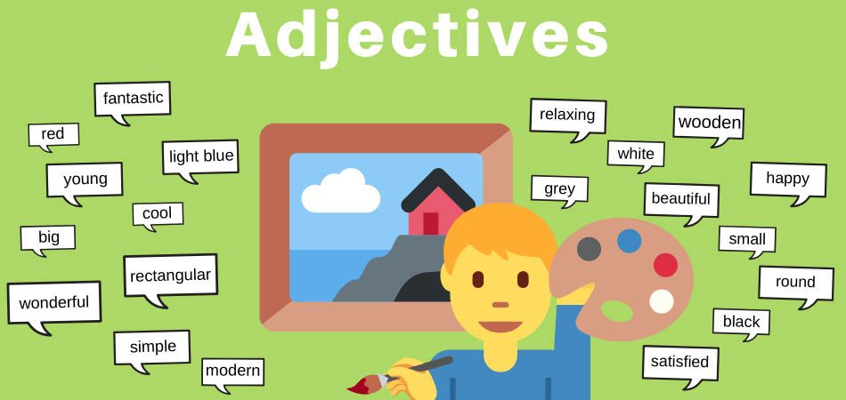
Qualitative data methods
Vocabulary
Adjectives – Descriptive words Statistics - collecting and analysing numerical data in large quantities.
Cannot statistically analyse qualitative data- qualities do not have a number attached to them
It’s difficult to determine the affective & cognitive components of a person’s attitude
One good way to do this is to ask them- Self Reports
Self Reports comprise of:
Qualitative Data:
Open-Ended Interviews
Indirect Questioning
Concept development
In-direct questioning
Subjects are asked to write down adjectives that they would use to describe their attitude towards a person, object or experience.
Adjectives are then analysed to determine if a person has a positive or negative attitude towards the topic.
Can assess sets of beliefs or ideas relevant to participant.
Useful in developing an attitude scale for a L.ikert scale
Check for understanding
Describe in-direct questioning Explain the strength and weaknesses of qualitative data

Slide 5
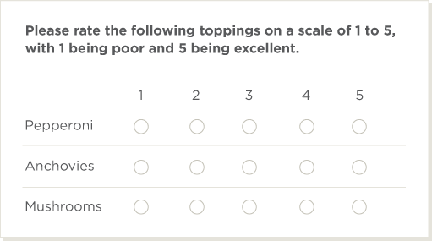
Quantitative data methods
Vocabulary
Statistics - collecting and analysing numerical data in large quantities.
Information collected in numerical form which can then be used to statistically describe a characteristic, behaviour or attitude.
To determine a persons cognitive and affective attitude components through quantitative data self reports also comprise of:
Quantitative Data:
Fixed-Response Questions
Likert-Scales
Concept development
Fixed response
All interviewees or survey participants are asked the same questions and asked to choose answers from among the same set of alternatives.
Several styles:
Yes/No/Undecided
True/False/Undecided
1%/5%/10%/no limit
Check for understanding
Describe fixed response Explain the strength and weaknesses of quantitative data

Slide 6

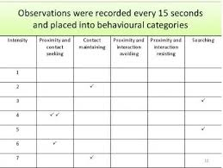
Observation data collection
Vocabulary
Circumstance - a fact or condition connected with or relevant to an event or action.
When a person is observed within a specific circumstance or environment and their behaviour within that circumstance or environment is recorded, this is mostly qualitative data.
The info recorded can be used to determine the behavioural component of an attitude.
People watched are usually unaware, therefore capture behavior that is more natural than behavior occurring in the artificial setting of a lab.
Strength: Useful when attitudes being investigated people may not want to be honest about. Somewhat free of participant bias.
Limitation: have to assume underlying attitude from behaviour, interpretation bias from experimenter.
Concept development
Check for understanding
Describe observation data collection Explain the strength and weaknesses of quantitative data

Slide 7
Activity 1
Your turn
Do some independent research into the data collection method: focus group.
You can use your textbooks or internet.
What is it?
When is it typically used?
What are the strengths?
What are the weaknesses?
4 minutes research
1 minute share with your group
2 minutes brainstorm as a class

Slide 8
Complete now/for homework
Practice Exam Questions over the next few slides culture and values: Attitudes
5 questions in total

Slide 9
Q1: Outline Sherif et al experiment (5 marks)
Q2: As a doctor, Ellen knows that Down syndrome is genetically caused condition that leads to an intellectual disability. When Ellen became pregnant, show knew she should probably abort her baby if she knew that it will be born with Down syndrome because the baby will be abnormal and have poor quality of life. However, she also feels the guilt and pain of losing a child.
Identify the affective, behavioral and cognitive components to this attitude, as well as the strength and direction of the attitude. (5 marks).
Q3: Lesly is a strict Catholic and strongly values life, believing it is sacred and should be considered over free will and convenience. Lesly was horrified to hear that Ellen would have an abortion, telling her that she would be a murderer. (5 marks)
Identify the affective, behavioral and cognitive components to this attitude, as well as the strength and direction of the attitude.

Slide 10
ANSWERS
Q1: Outline Sherif et al experiment (5 marks)
Aim was to test realistic conflict theory, that if two or more groups are seeking the same limited resources, this will lead to conflict, negative stereotypes and beliefs, and discrimination between the groups.
Participants: The researchers took 22 white middle-class, 12-year-old boys and split them into two groups.
Procedure: The researchers had the boys compete for a prize using various competitions between two groups, such as tug-of-war. OR Researchers later forced the groups to work together to reach common goals, such as fixing the camps water supply.
Results: Prejudicial attitudes occurred quickly through name calling and taunting, this quickly escalated to burning each others' flags, teasing private properly and physical aggression. OR Cooperation phase eased prejudice and tension among the groups, as one group allowed the other to drink first as they did not have their water bottles with them.
In conclusion, when people compete for scarce resources (e.g. jobs, land etc.) there is a rise in hostility between groups. OR When people are forced cooperate in the right conditions, negative attitudes between groups are decreased.

Slide 11
Answer Q2
Description for marks | 5
Affective: Guilt and pain Behavioral: Would abort her baby Cognitive: If born with Down syndrome the baby will be abnormal and have poor quality of life | 1 1 1
Attitude strength: Weak, use of ‘probably’ and conflicting affective and cognitive components. Attitude direction: Positives for abortion | 1 1

Slide 12
Answer Q3
Description for marks | 5
Affective: Horrified that someone would have an abortion Behavioral: Telling Ellen she would be a murderer Cognitive: Life is sacred and should be considered over free will and convenience. | 1 1 1
Attitude strength: Strong, shown through strong feelings and behaviors. Attitude direction: Negative towards abortions | 1 1

Slide 13
Q4: When Dave was 14 years old, he was in a car crash which was caused by a drunk driver. Dave becomes very angry at his friends if they consider driving home when under the influence, as he knows that they could seriously injure themselves and others. He often hides their keys when they are drunk so they are forced to stay or take an uber.
Identify the affective, behavioral and cognitive components to this attitude, as well as the strength and direction of the attitude. (5 marks)
Explain how Dave’s attitude was formed. (2 marks)

Slide 14
Answer Q4
Description for marks | 5
Affective: Angry at his friends Behavioral: He often hides their keys to prevent them for driving home. Cognitive: He knows that they could seriously injure themselves and others if they drive home drunk. | 1 1 1
Attitude strength: Strong, shown through strong feelings and behaviors. Attitude direction: Negative towards drink driving. | 1 1
Dave’s attitude was formed through direct experience, as he discovered the horrible impacts on people drink driving can have when his life was personally impacted by the behavior. | 1-2

Slide 15
Q5 – mini extended response
Nick, a high school student was physically abused at school as students suspected he was gay. A group of four boys called him names and punched him. One of those boys, Marcus was always told by his father that homosexuals were inferior to heterosexuals because they were not ‘normal’, as relationships and families must be between a man and a woman.
When the teacher found out about the incident, she was trying to figure out how to reduce sexual prejudice in her classroom. She read an article that explained how heterosexuals with a gay friend or relative have significantly more favourable attitudes toward lesbians and gay men as a group.
Identify, define and apply two factors that lead Nick to form sexual prejudice (6 marks).
Define inter-group contact (1 mark).
Describe two considerations that the teacher should incorporate in her lessons to reduce prejudice in her classroom using inter-group contact (4 marks).

Slide 16
Answer Q5
Description | Marks
Identify, define and apply two factors that lead Nick to form sexual prejudice | 6
Identify: Group prejudice Define: a negative attitude towards a group of people that is formed through conforming to group norms. Apply: The other boys in the group that were abusing Nick may not have originally agreed that Nick deserved to be abused, but followed along to fit into the group to be accepted. | 1 1 1
Identify: Group categorization / in-group out-group Describe: Categorizing into differentiating groups, increasing the perception of differences between groups and overemphasizing similarities within groups. Apply: Marcus learned group categorization, identification and comparison from his father, believing that believes heterosexuals are better (and more similar to him) and homosexuals are lesser (and very different from him) / Marcus learned from his father that homosexuals are out-group and heterosexuals are his in-group. | 1 1 1
Define inter-group contact | 1
Inter-group contact is increased contact between people of different groups to make people aware of similarities and reduce prejudice. | 1
Describe two considerations | 4
Possible answers include but are not limited to: Inter-group contact must be sustained or last over a prolonged period of time. The teacher needs to make sure students of different sexual orientation work together for an entire term in order to form relationships and empathy. Inter-group contact must be with people of equal status and power, which can be applied by giving equally important group roles in collaborative activities. Inter-group contact should include superordinate goals which exceed lesser goals, the teacher should create group competitions and project work that allows students to work towards winning or achieving a high grade together. | 1-2 1-2 1-2

